Slide 1

PROJECT ANALYSIS
By
BATCH-4
SAVE
SMART
A Bhavya Sai
B Preethi
K Sujana
S Arun
P Pratap Reddy

Slide 2
Software used
➢ Eclipse IDE
➢ VS code
➢ My SQL
➢ JAVA
➢ Windows 10
➢ Angular

Slide 3
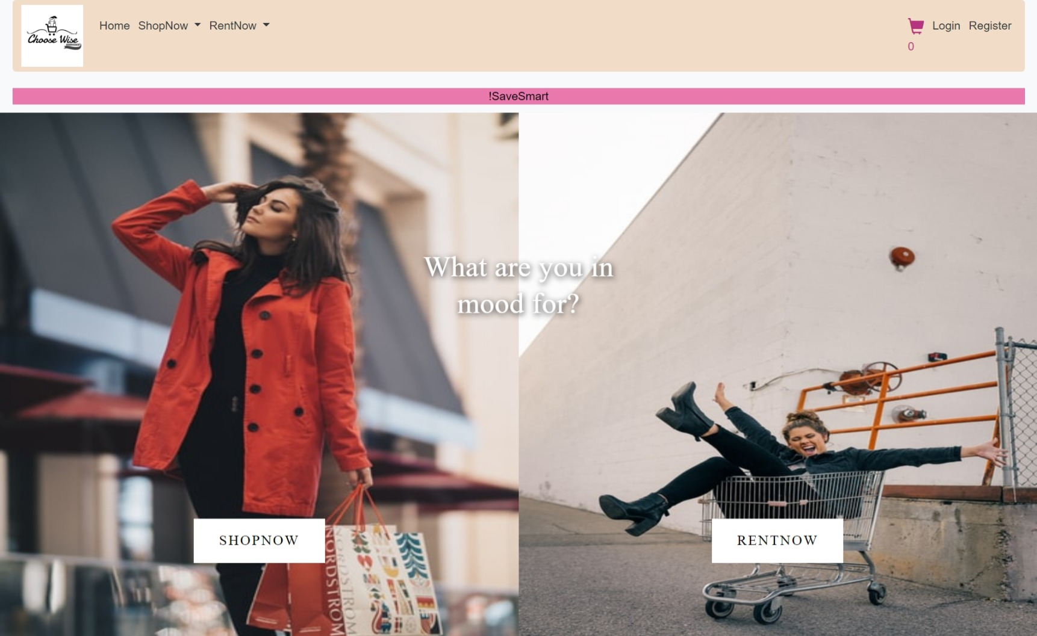
1.Home

Slide 4
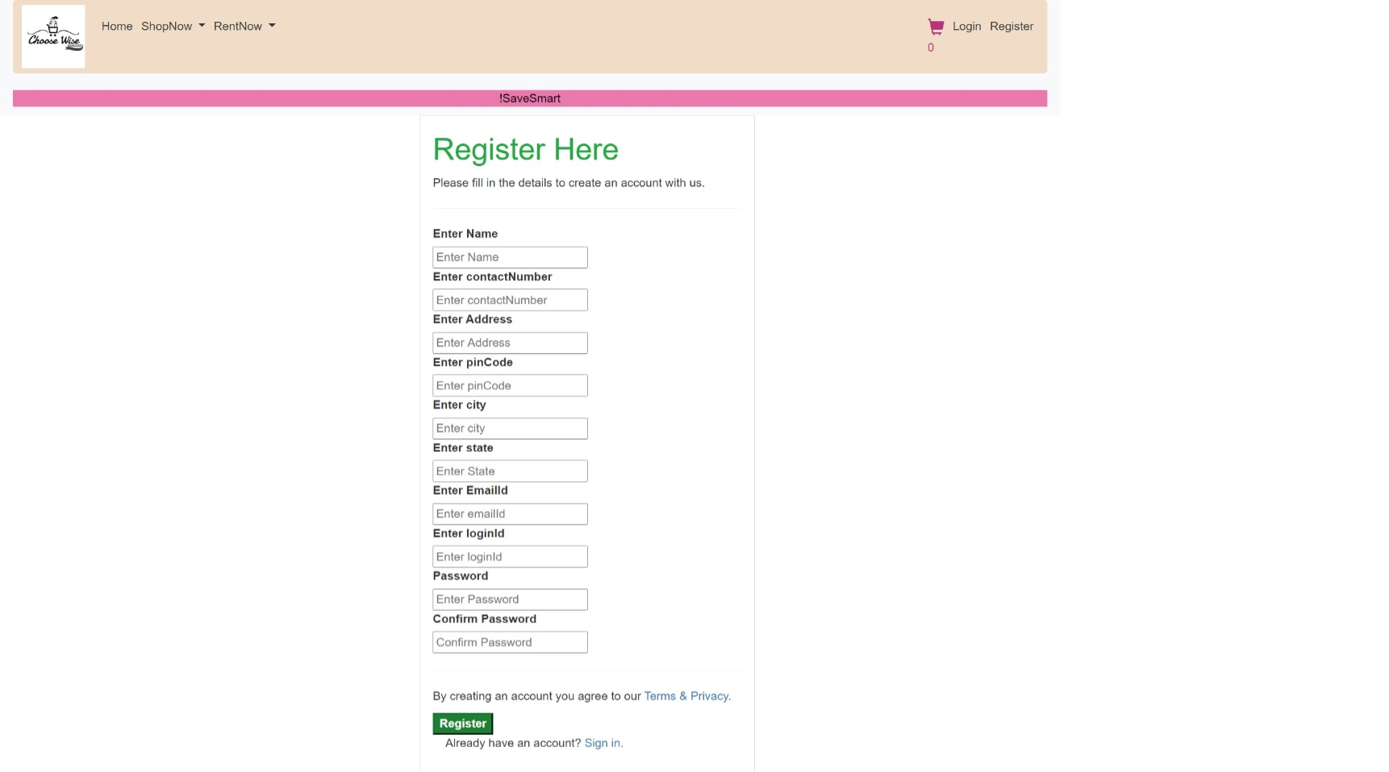
2.Register

Slide 5
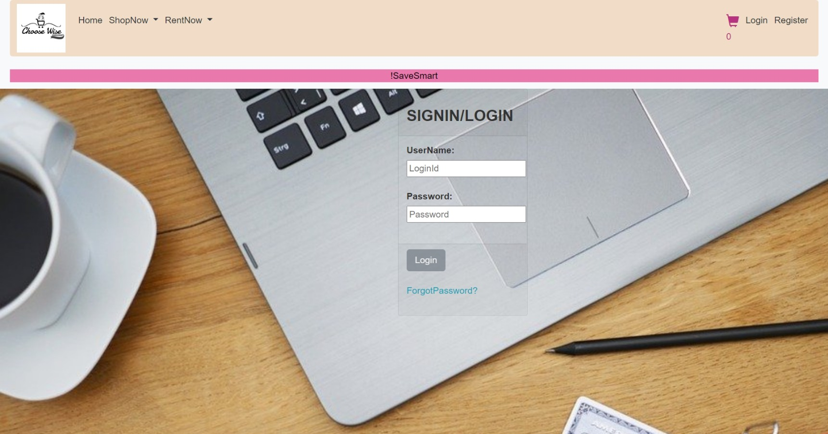
3. Login

Slide 6
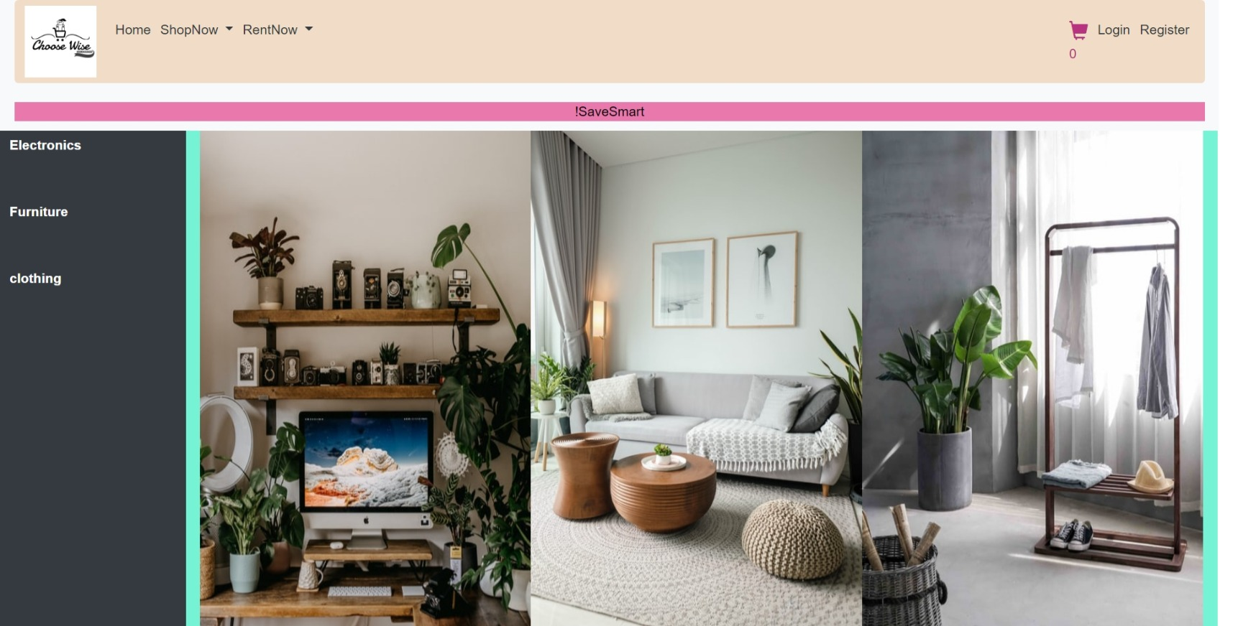
4.Shopnow

Slide 7
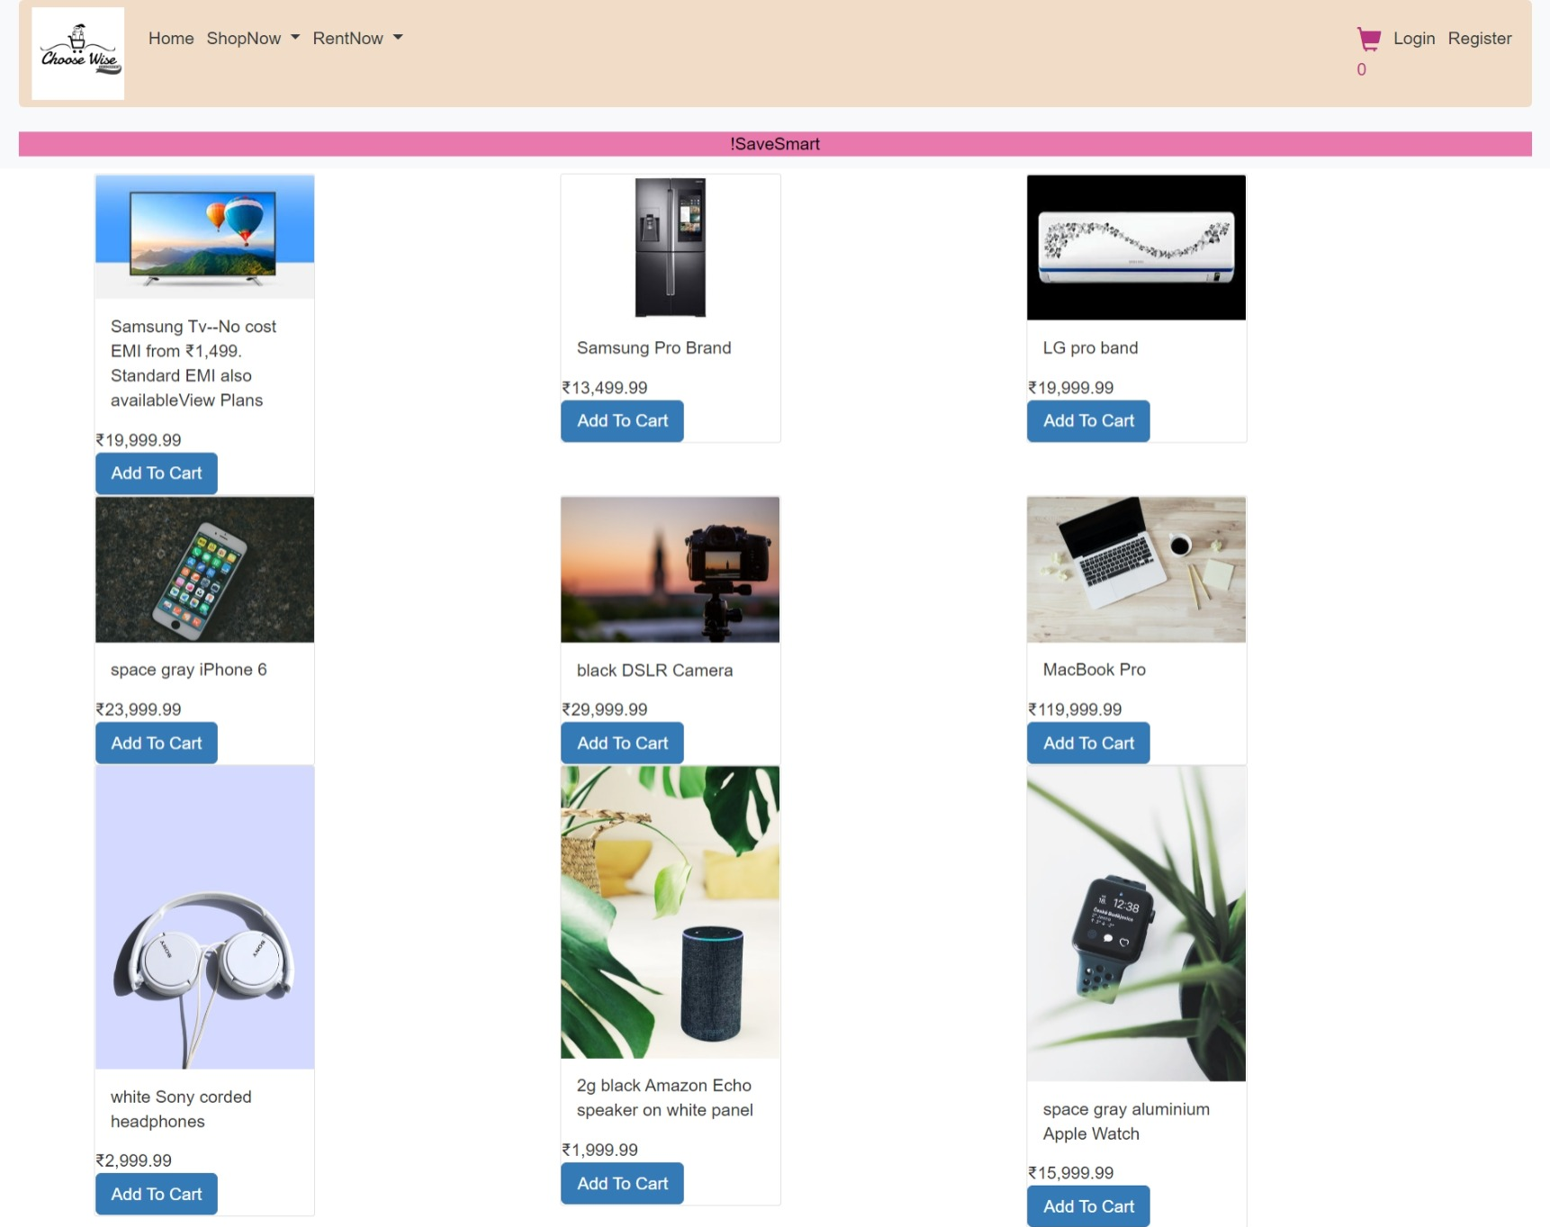
5.Electronics

Slide 8
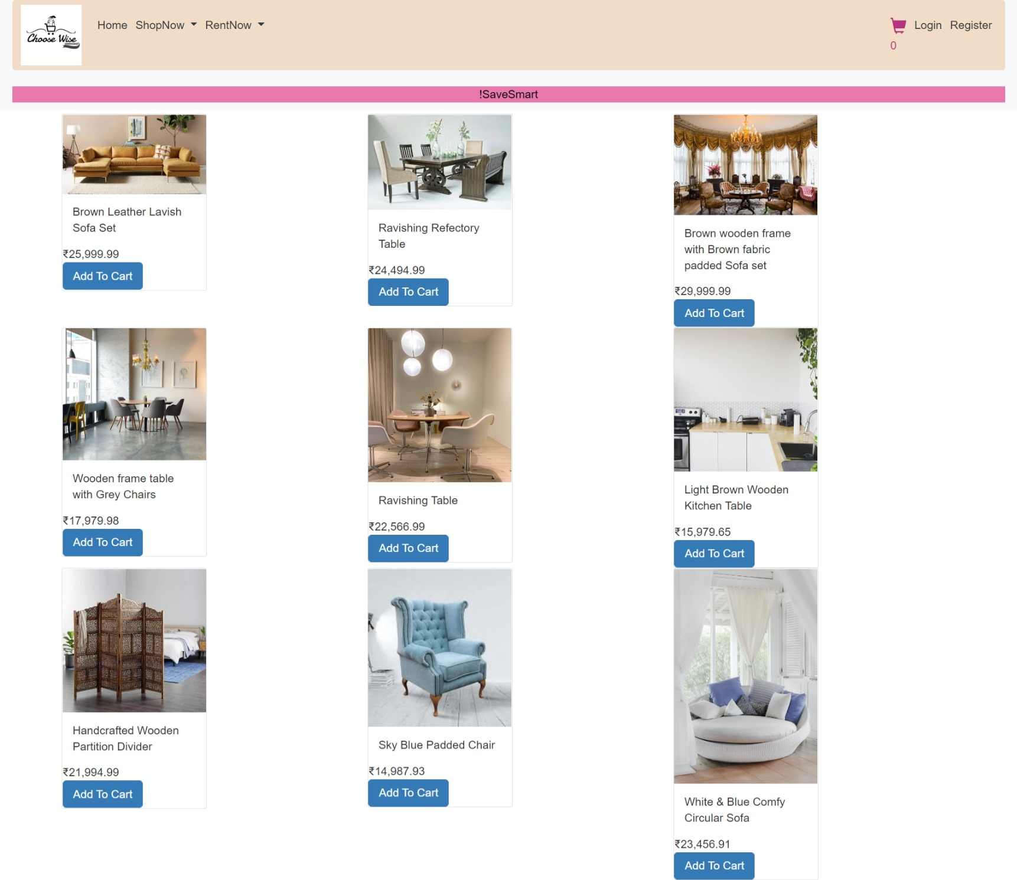
6. Furniture

Slide 9
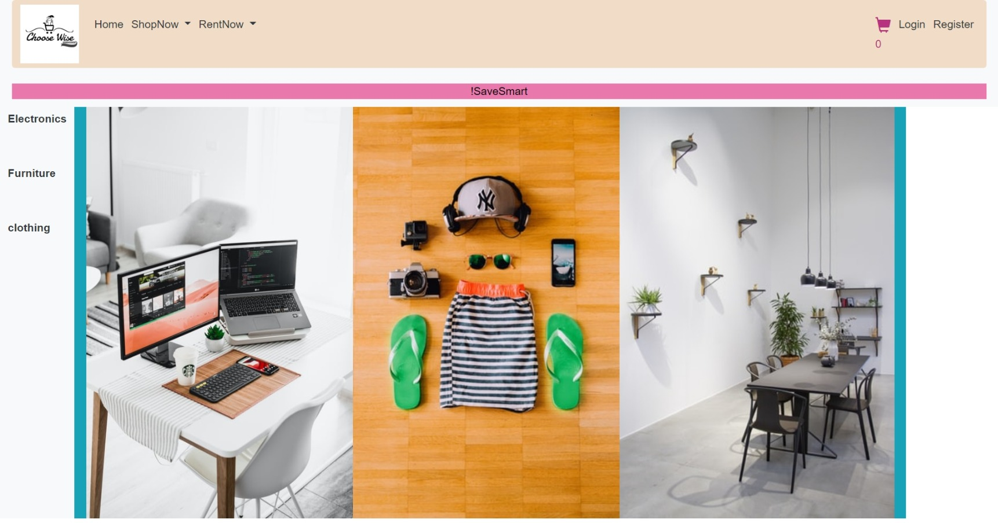
7.Rentnow

Slide 10
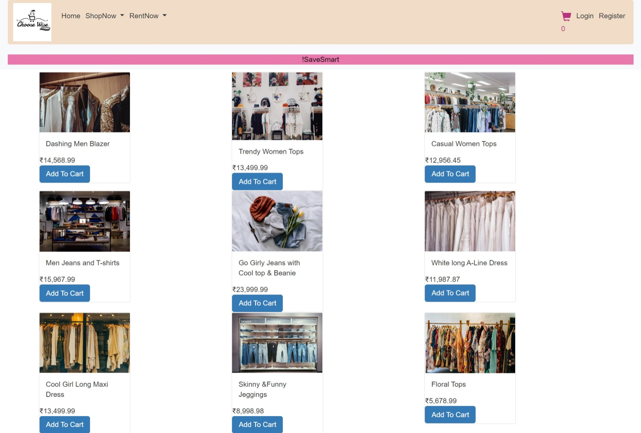
8. Clothes

Slide 11
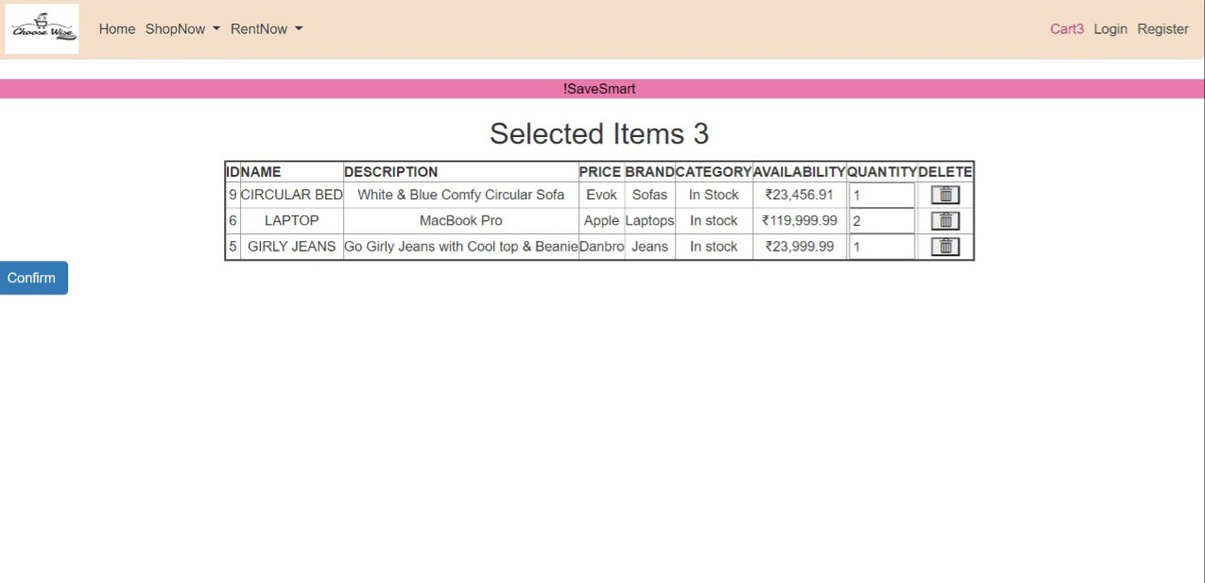
9.Cart

Slide 12
Project Analysis
Home
Registration
Login
Electronics
Rentnow
Electronics
Shopnow
Furniture
Furniture
Clothing
Clothing

Slide 13


